Slide 1
Inclusive Higgs Rate with Forward Detection at High Energy Muon Collider
Kun-Feng Lyu
University of Minnesota
In collaboration with Peiran Li and Zhen Liu
Muon Collider Benchmark Physics Workshop
Nov 17, 2023
1

Slide 2
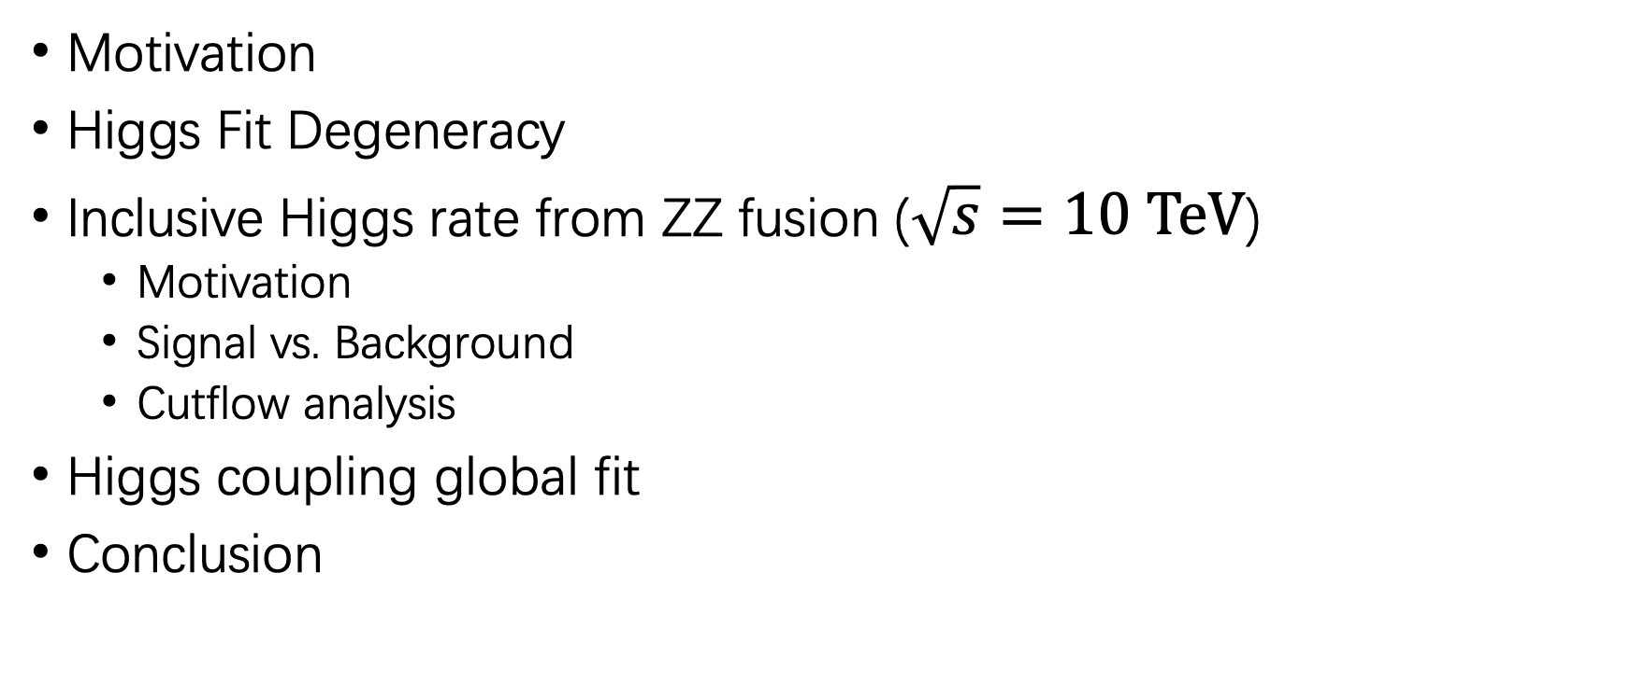
Outline
Motivation
Higgs Fit Degeneracy
Inclusive Higgs rate from ZZ fusion ($\sqrt{s}=10 TeV$)
Motivation
Signal vs. Background
Cutflow analysis
Higgs coupling global fit
Conclusion
2

Slide 3
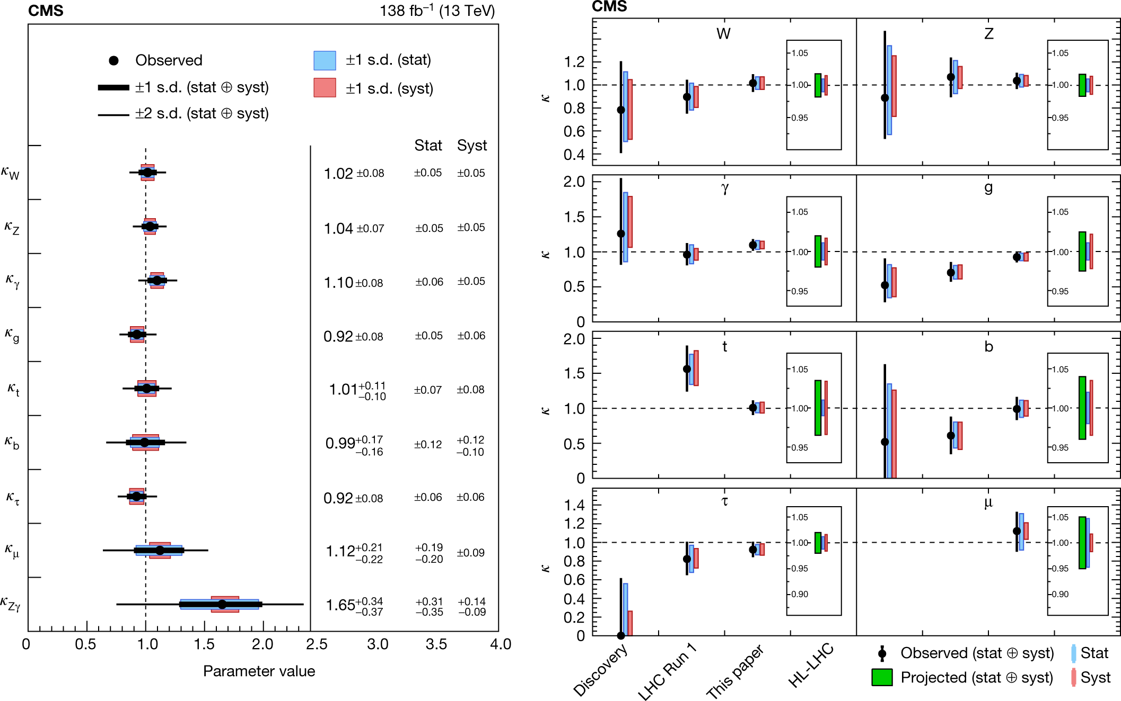
Motivation
Nature volume 607, 60–68 (2022)
Higgs boson has been discovered over ten years ago.
Higgs is still the central player of many mysteries and puzzles.
We need to have deeper understanding of the Higgs properties.
Currently we can measure the higgs coupling to above 5%
3

Slide 4
Measurements to be interpreted
Observables at the colliders are the cross sections, a convolution of PDF, hard scattering, parton shower, detector response …
For the hard scattering under the narrow width approximation:
All onshell channels can be parametrized this way, simple extension possible for more channels/observables.
4

Slide 5






Higgs Fit Degeneracy
Under the rescaling ,
would be invariant if
For
For
$$t^{2}$$
$$t^{4}$$
No exotic branching ratio can satisfy, so degeneracy is broken
$$t^{−2}$$
$$t^{2}$$
Certain exotic branching ratio can always satisfy, we cannot break the degeneracy.
$$t^{4}$$
$$t^{−2}$$
People typically assume or
which means is not a free parameter
We need to introduce new types of observables. One possibility is just from the inclusive measurement.
5

Slide 6
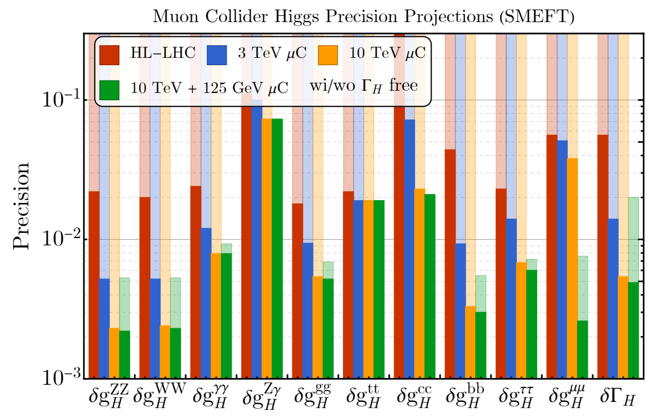
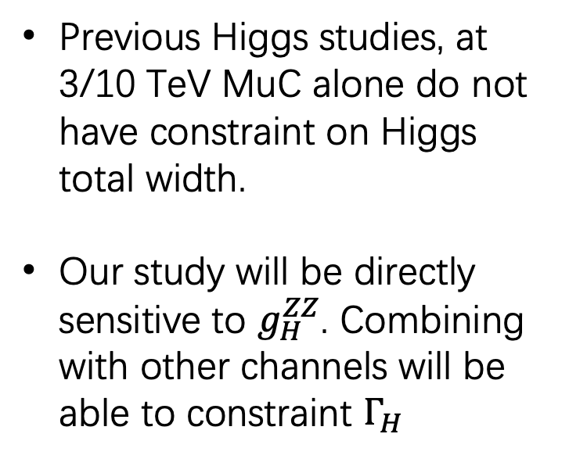
Previous Higgs studies, at 3/10 TeV MuC alone do not have constraint on Higgs total width.
Our study will be directly sensitive to $g_{H}^{ZZ}$. Combining with other channels will be able to constraint $Γ_{H}$
[2209.01318] Muon Collider Forum Report

Slide 7
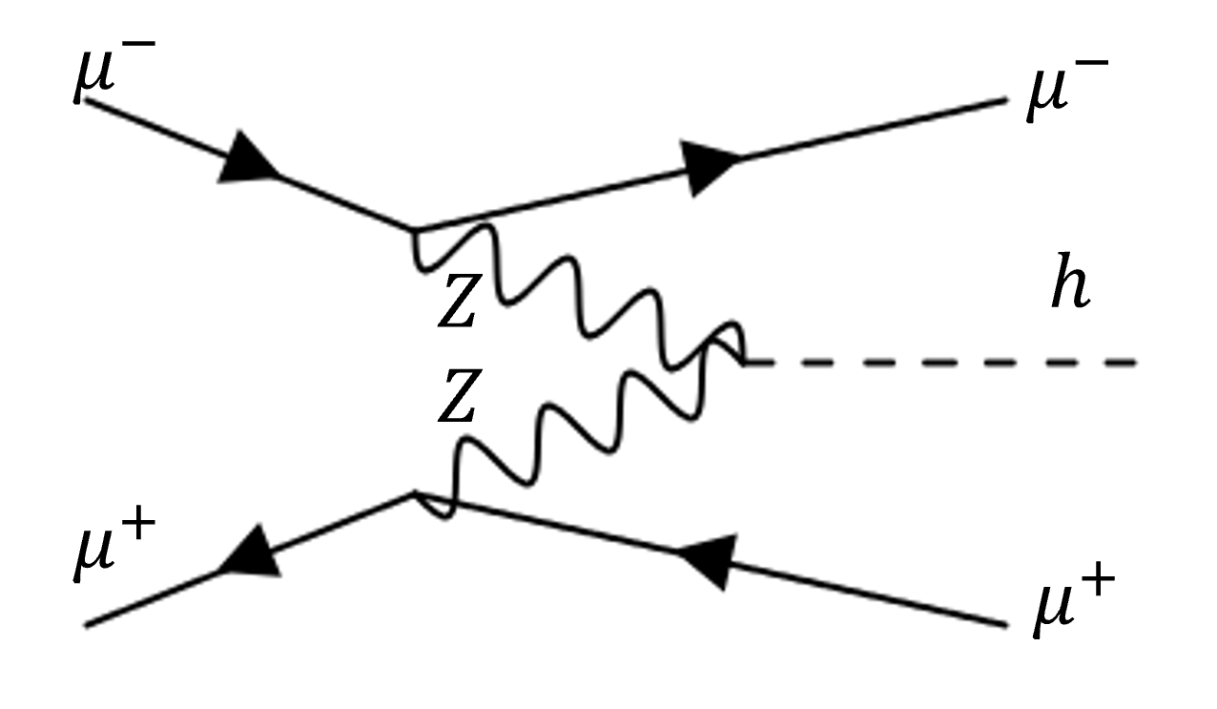
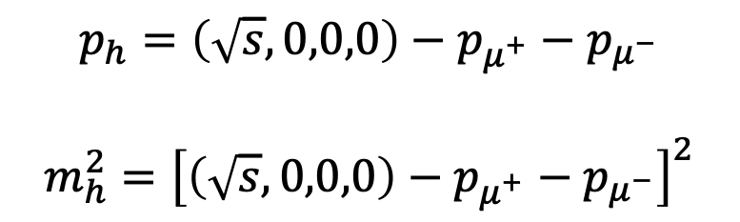
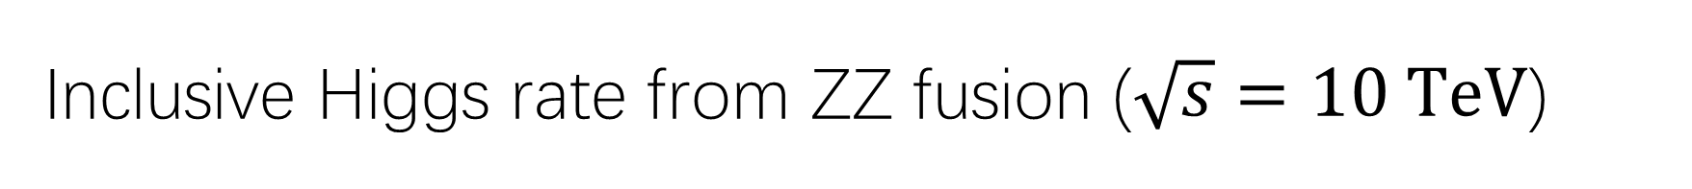
Inclusive Higgs rate from ZZ fusion ($\sqrt{s}=10 TeV$)
Forward muon detector: $2.5<η\left(μ\right)<4, 6, 8$
Ultra-energetic muons would penetrate the shielding nozzles
$$p_{h}=\left(\sqrt{s},0,0,0\right)−p_{μ^{+}}−p_{μ^{−}}$$
$$m_{h}^{2}={\left[\left(\sqrt{s},0,0,0\right)−p_{μ^{+}}−p_{μ^{−}}\right]}^{2}$$
Recoil mass of dimuon
Does not rely on the detection of Higgs decay product.

Slide 8
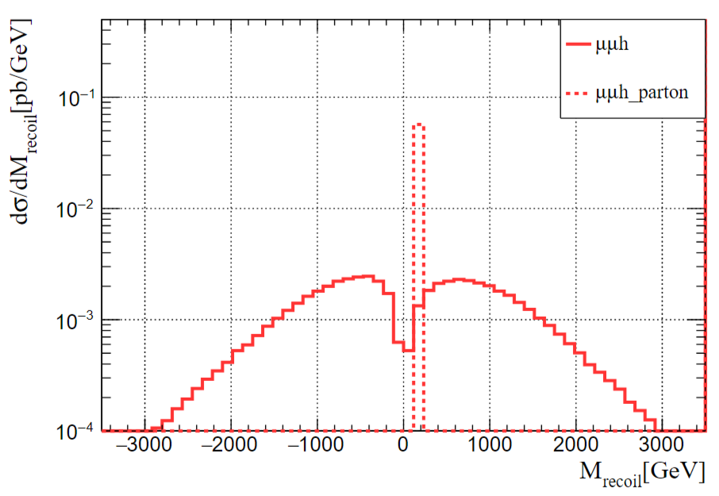

Inclusive Higgs rate from ZZ fusion ($\sqrt{s}=10 TeV$)
Due to the uncertainty of high energy measurement, the smearing effect will distort the recoil mass distribution.
Fast detector simulation using Delphes.
$${\left[\left(\sqrt{s},0,0,0\right)−p_{μ^{+}}−p_{μ^{−}}\right]}^{2}<0$$

Slide 9
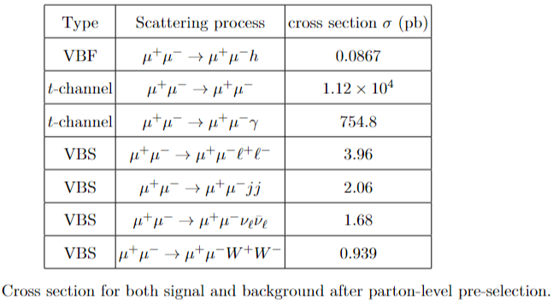
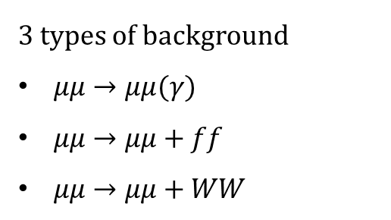
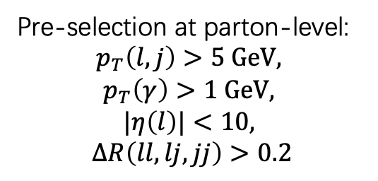

Signal vs. Background ($\sqrt{s}=10 TeV$)
Only tag 2 forward muons
Pre-selection at parton-level:
$$p_{T}\left(l,j\right)>5 GeV,$$
$$p_{T}\left(γ\right)>1 GeV,$$
$$|η\left(l\right)|<10,$$
$$ΔR\left(ll,lj,jj\right)>0.2$$
Do not have any requirements on other detection.
3 types of background
$μμ→μμ(γ)$
$μμ→μμ+ff$
$μμ→μμ+WW$

Slide 10
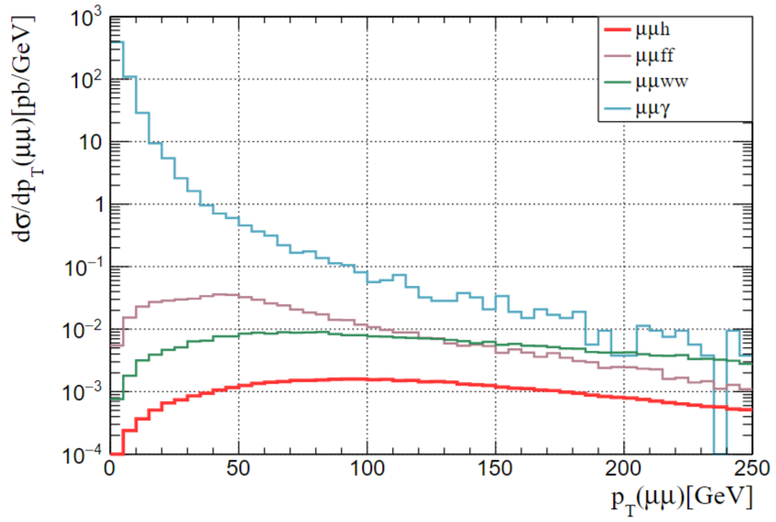

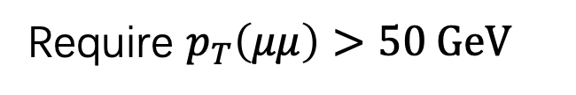

Signal vs. Background ($\sqrt{s}=10 TeV$)
Require $p_{T}\left(μμ\right)>50 GeV$
Merging $μμ→μμ$ and $μμ→μμγ$

Slide 11
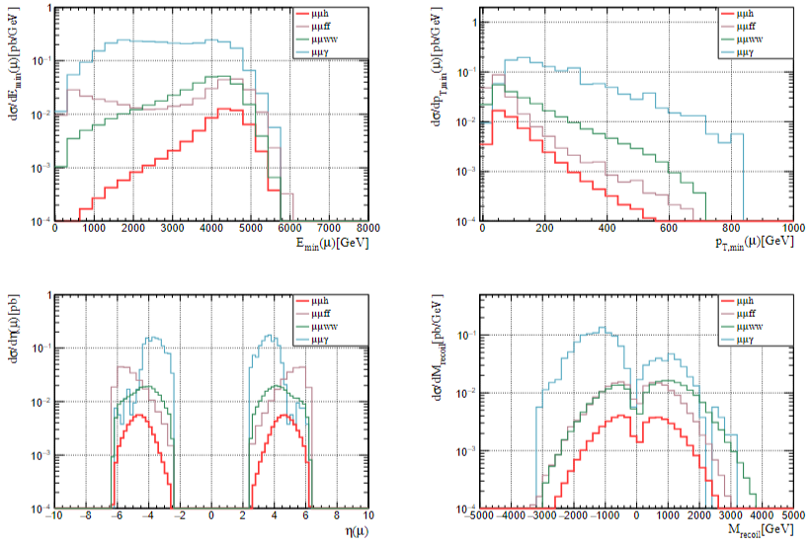
Cutflow analysis
Checking other kinematics and applying a few cuts.

Slide 12
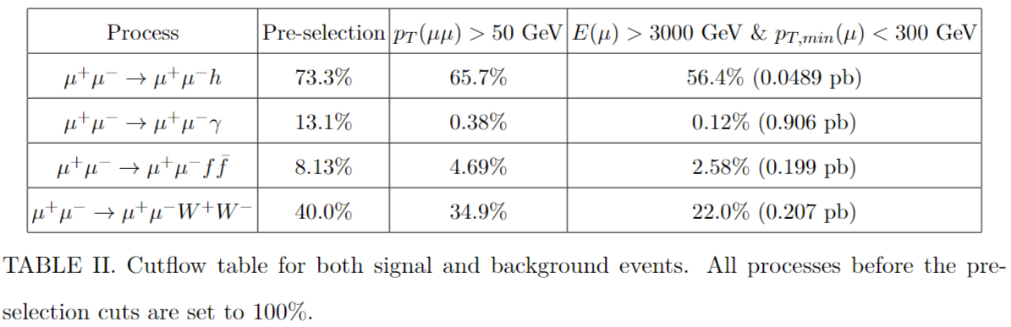
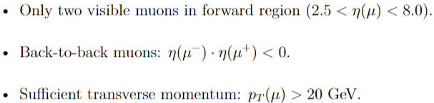
Cutflow analysis
Checking other kinematics and applying a few cuts.
Detector level pre-selection:

Slide 13
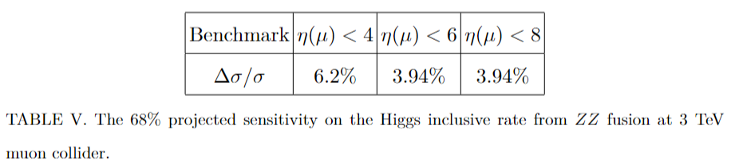
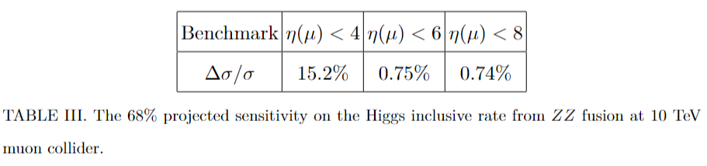
Sensitivity
3 TeV
10 TeV
13

Slide 14
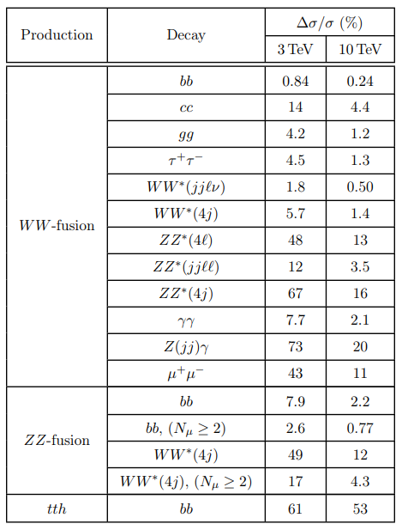
Higgs coupling global fit
We preform the chi square analysis via combining
(1) All kinds of on-shell channels,
(2) Indirect search for top yukawa,
(3) Invisible decay branching ratio using forward muon
(4) Our inclusive ZZ fusion measurement
at 3/10 TeV Muon Collider
We further combine with HL-LHC and CEPC.
Matthew Forslund and Patrick Meade. [2203.09425] High Precision Higgs from High Energy Muon Colliders
Zhen Liu, Kun-Feng Lyu, Ishmam Mahbub, Lian-Tao Wang. [2308.06323] Top Yukawa Coupling Determination at High Energy Muon Collider
M. Ruhdorfer, E. Salvioni, A. Wulzer. [2303.14202] Invisible Higgs from forward muons at a muon collider
Our inclusive Higgs rate result.
14

Slide 15
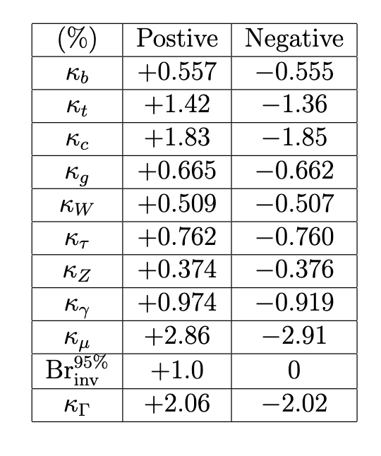
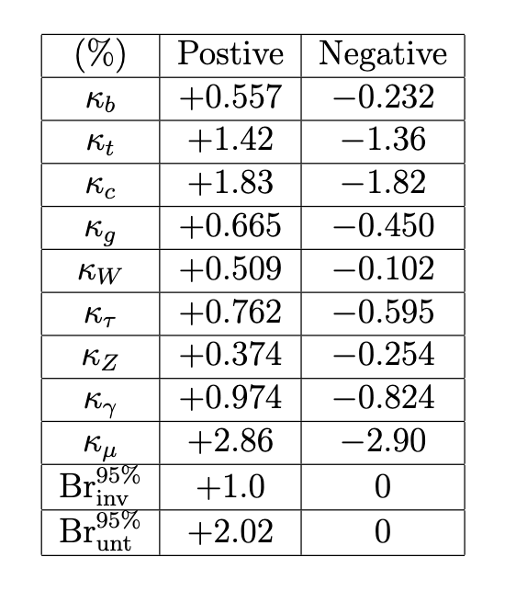
Kappa Basis Choice
Almost symmetric around SM point
Physical!
15

Slide 16
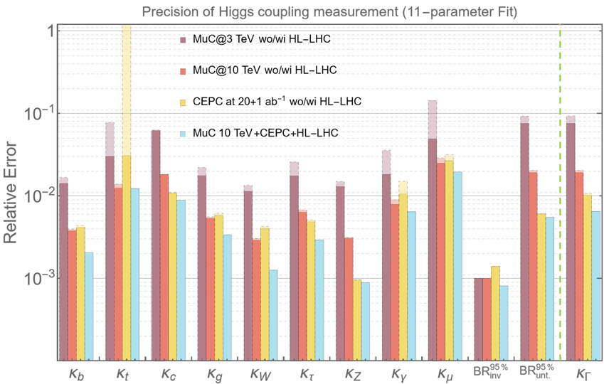
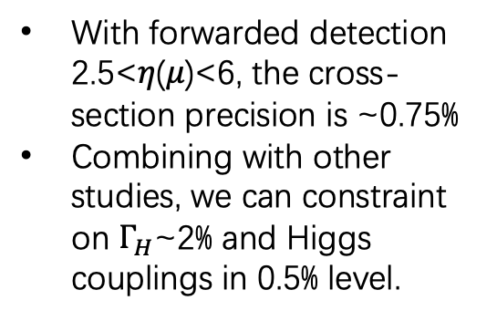
Higgs coupling global fit
With forwarded detection 2.5<𝜂(𝜇)<6, the cross-section precision is ~0.75%
Combining with other studies, we can constraint on $Γ_{H}$~2% and Higgs couplings in 0.5% level.

Slide 17
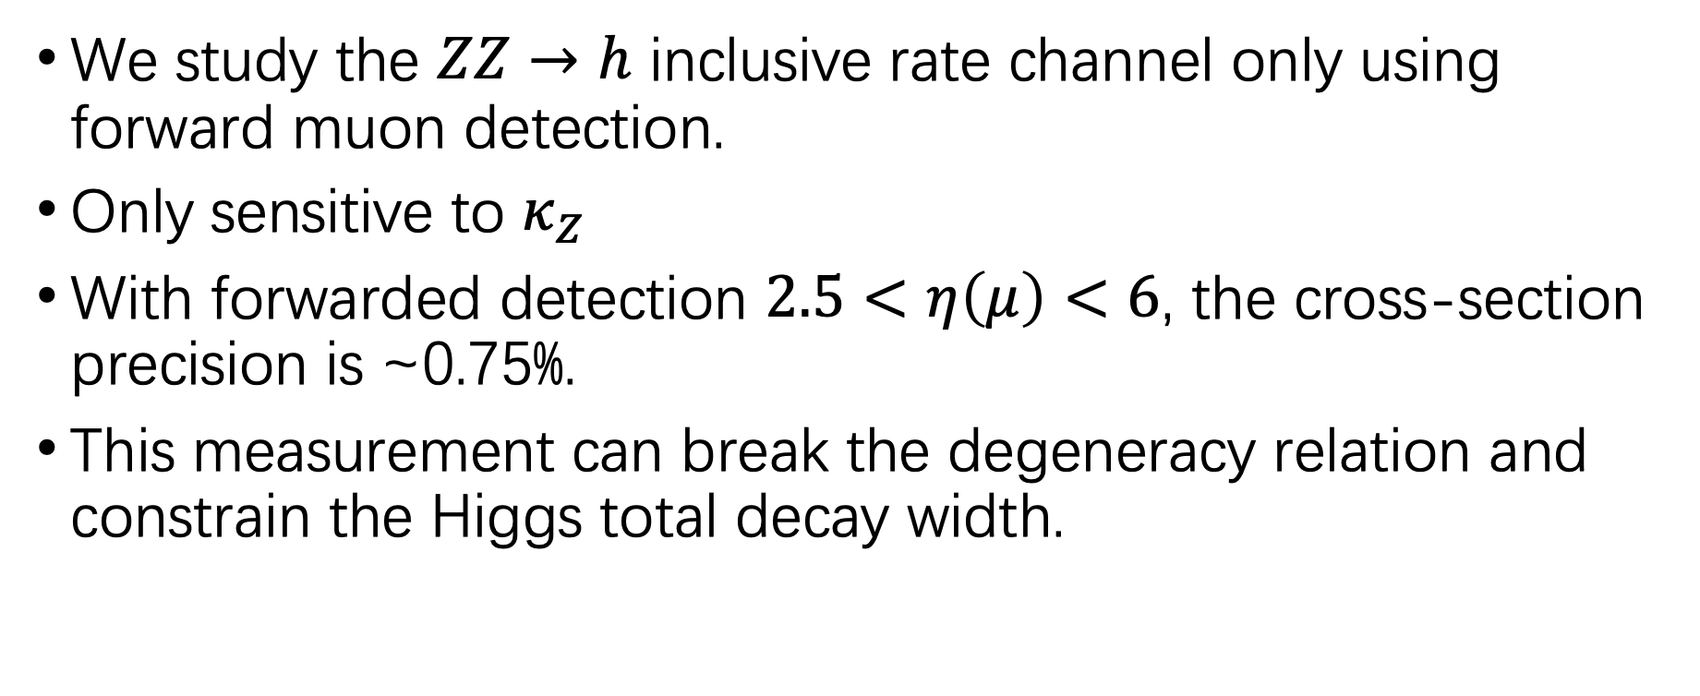
Conclusion
We study the $ZZ→h$ inclusive rate channel only using forward muon detection.
Only sensitive to $κ_{Z}$
With forwarded detection $2.5<η\left(μ\right)<6$, the cross-section precision is ~0.75%.
This measurement can break the degeneracy relation and constrain the Higgs total decay width.

Slide 18
Backup

Slide 19
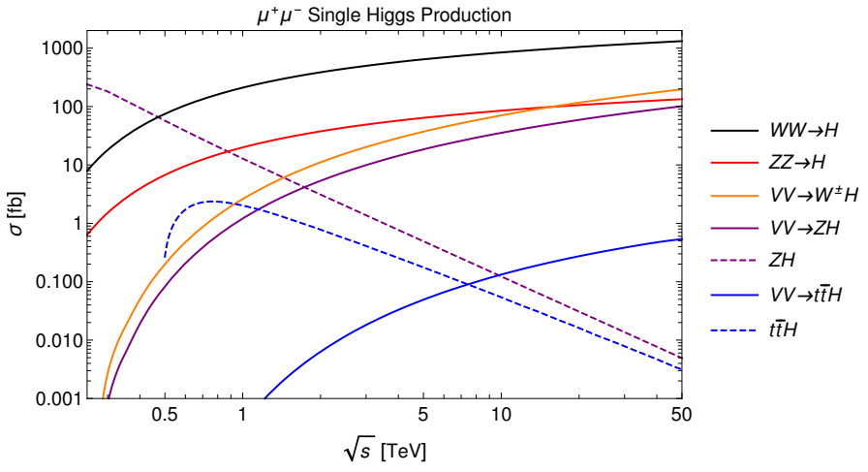
Higgs productions at Muon Collider
Our study
Matthew Forslund, Patrick Meade, [2203.09425]

